Slide 1
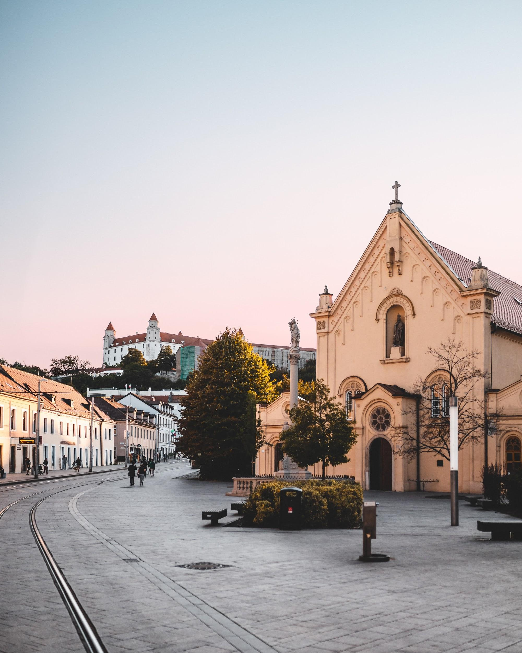

Bratislava city app
Team Bratislava_app
GATE 3

Slide 2

Project story
Create
simple and efficient tool for users of Bratislava public transport
Provide
all the relevant and live public transport information at hand.
Ensure
sustainable mobility of public transport.

Slide 3
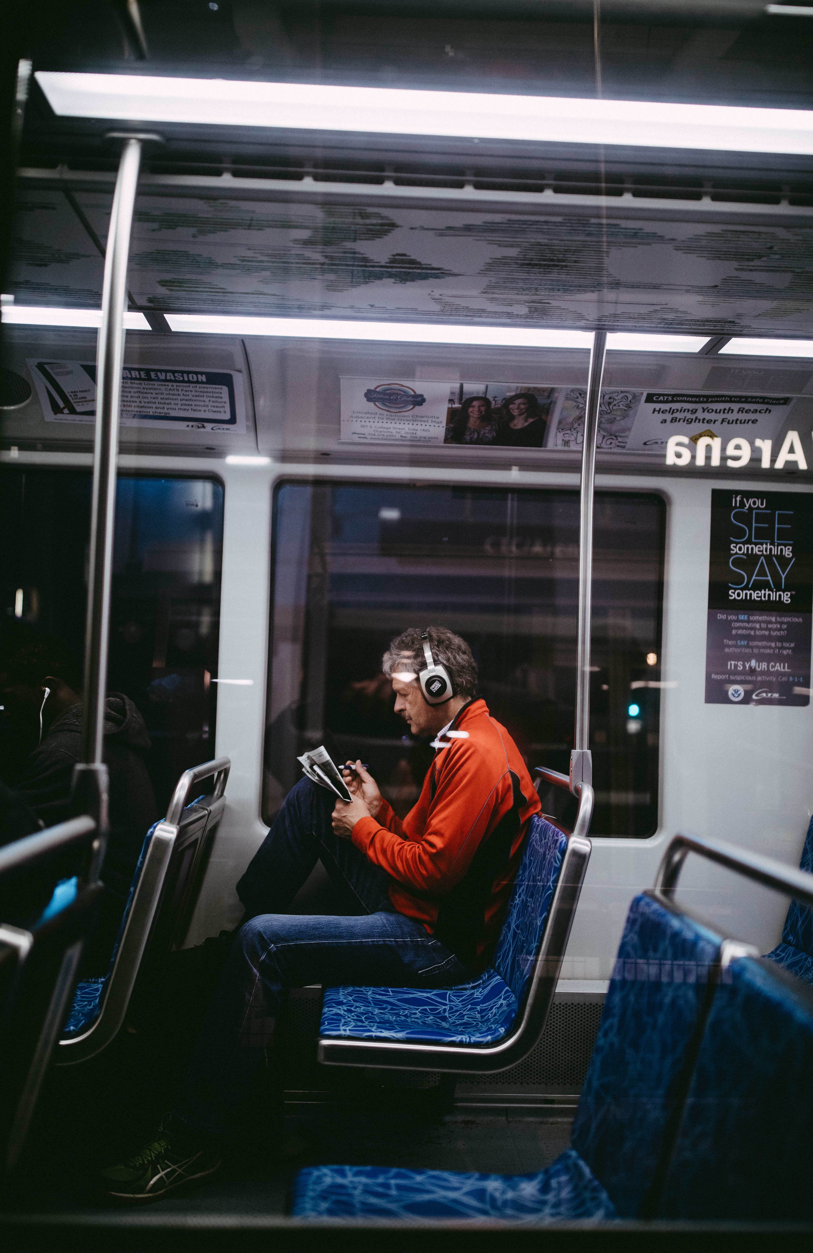
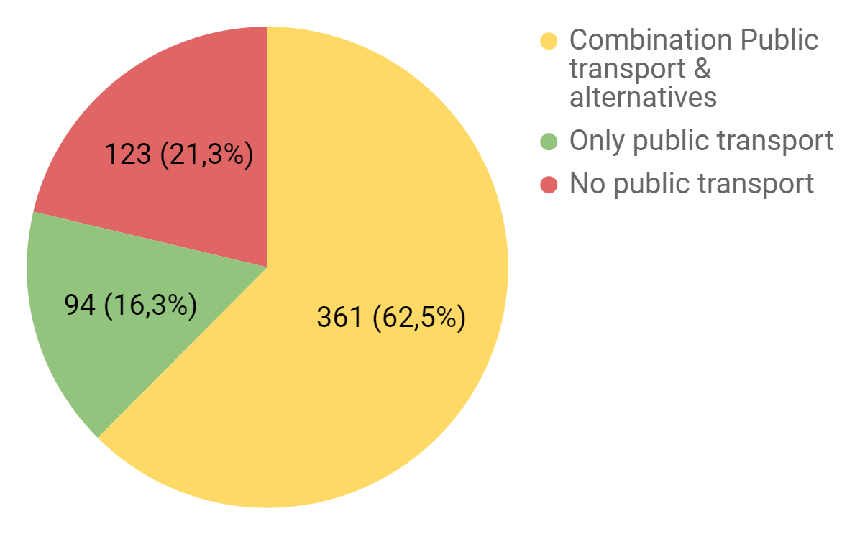
Who is the end user?

Slide 4
How we got the result?
600
99%
5%
79%
Target group of survey
We selected a sample of people for the best value at 500 K population
Success rate
The percentage success rate for a given sample
Error rate
The error rate for a given sample
End user
Usage of public transport in Bratislava

Slide 5
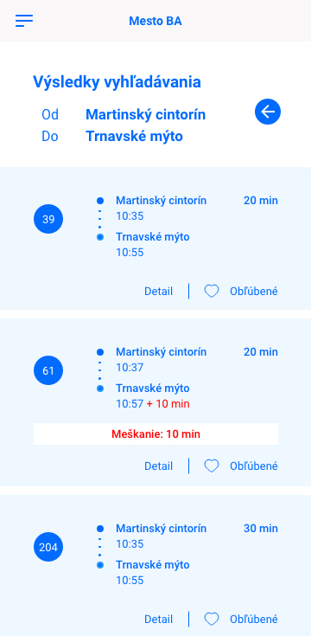
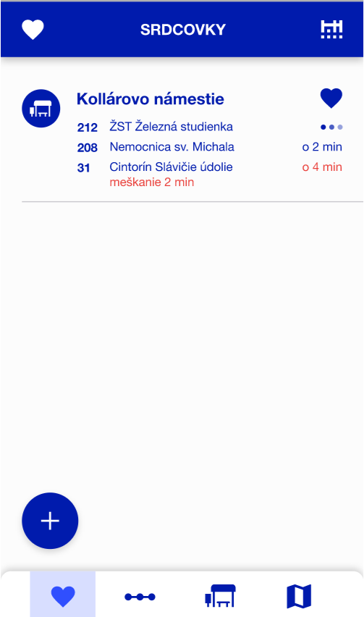
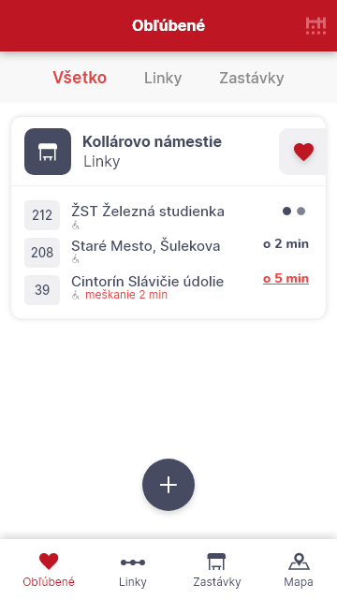
User interface progress
GATE1
GATE2
GATE3

Slide 6
Development progress
Notes:
obkecat databazu, datovy model a backend - rest API resources
Llukas

Slide 7






What is done & next steps
GATE 3
GATE 4
Lines and stops
Map with Stops
Map with Bikes
Favourites
Delays
Departure Board
Notes:
we had to keep of prioritisation process. we used I/E krat C - impact vs. confidence vs. efficient, which helped to organize development process. we focused on the most important features . next features gonna be done to gate 4
LUKAS

Slide 8
Notes:
LUKAS
Prečo sa robi
Prezentacia aplikacie
Zber beta testerov ktori su potrebni na test funkcionalit este pred finalnou verziou app.
Aktualne screen mozete vidiet

Slide 9




Comparison against competitors
Functionalities | BA City App
Favourites
Departure board
Map with stops in different directions
Slovnaft bikes
Part of the larger ecosystem
Dashboard with Live data
Ease of Use

Slide 10
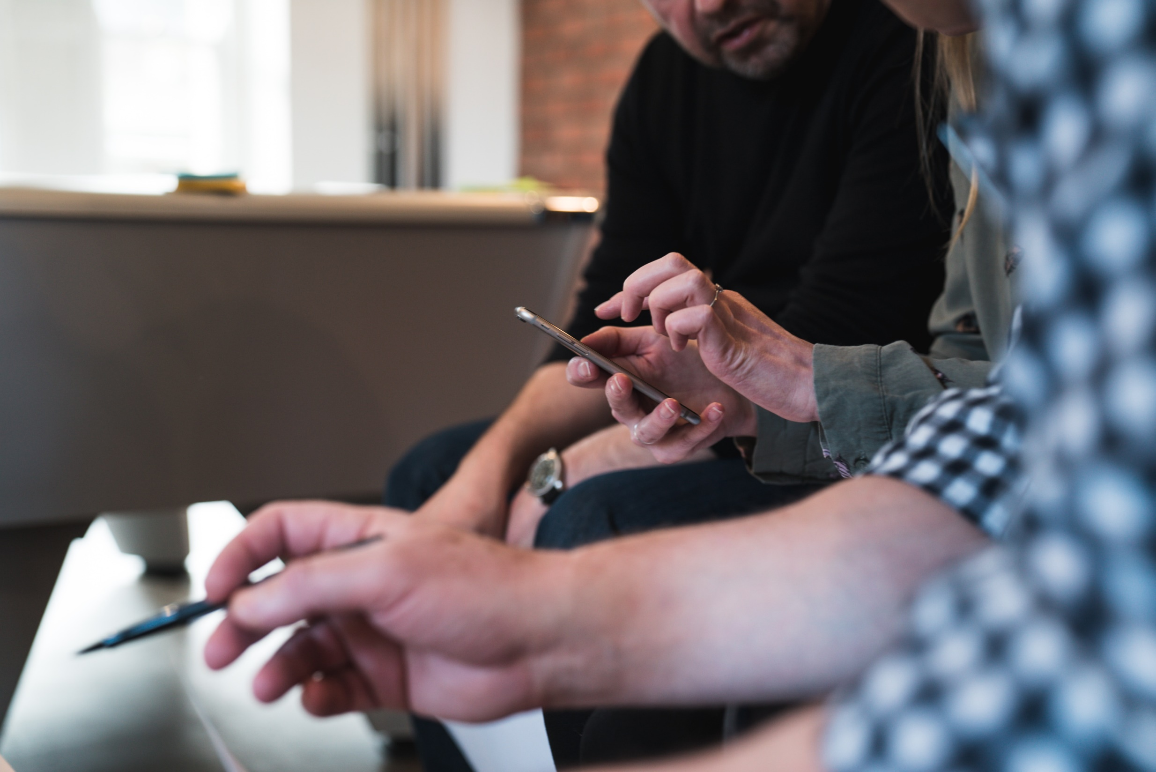
Requirements on stakeholder
Real-time data
Landing page hosting and sign-up
Promo-video

Slide 11

Public transport is the future!
Let´s test our Prototype. Yours feedback is important.

